Slide 1



DEPI Final Project
Skin Lesion Classification using Hybrid Data
Prepared by:
Heba Ismail Omar

Slide 2
1
Project Overview
2
Data Preprocessing
Contents
3
Data Analysis
4
Model Inititation
5
Model Training
6
Model Testing and Evaluation
7
Results

Slide 3
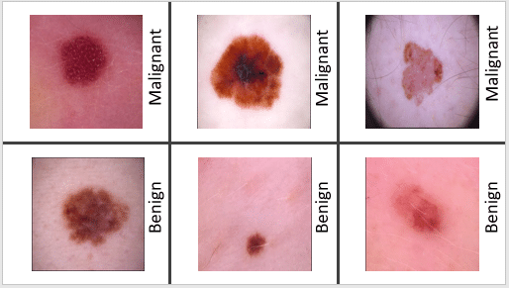
Project Overview
This project focuses on classifying skin lesions as either benign or malignant using a hybrid model that integrates image data and tabular metadata. The dataset is sourced from the ISIC 2024 Challenge, combining TBP images of skin lesions and metadata, such as lesion size, patient age, and anatomical site. This model uses deep learning techniques for image data and tabular data to predict the target label.

Slide 4
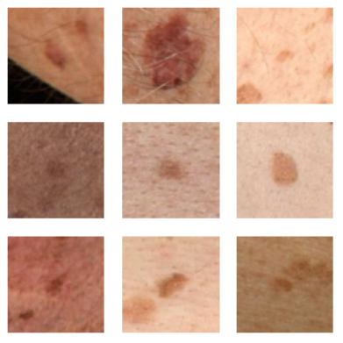
About the dataset
Image data
401K jpg images of skin lesions diagnostically labeled (0,1)
Each image name is its ID in the metadata csv file
Tabular data
Csv file containing metadata in the shape (401k, 55)
Features include:
Patient info: Id, sex, age, lesion site.
Lesion Image Features: geometry, color, intensity
Color-Related Features: Color standard deviation, luminance
Location Features: X, Y, Z coordinates
Symmetry and Shape Features
Diagnosis Related Features

Slide 5
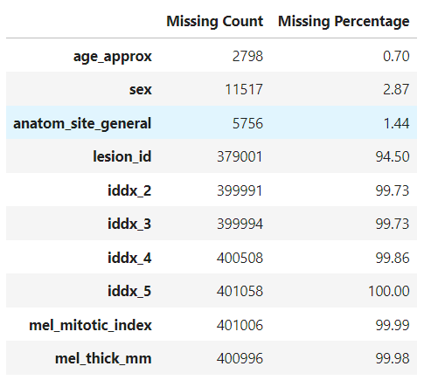
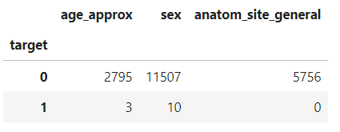
Tabular Data Preprocessing
Loaded the metadata csv file as pandas dataframe using pd.read_csv
Explored the dataframe, found many missing values
Calculated the count percentage of missing values for each column
Dropped columns with high percentage of missing values > 10%
Grouped by the 'target' column and count missing values for remaining columns
Filled missing values in other columns using forward fill method

Slide 6
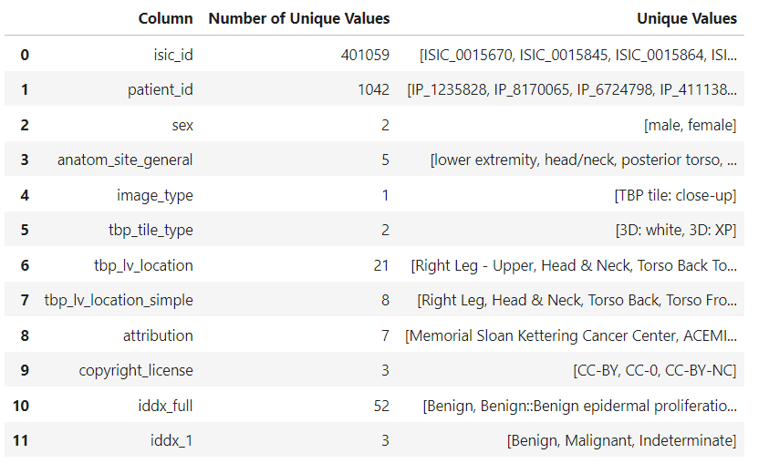
Tabular Data Preprocessing
Explored the object columns and dropped useless columns and columns that contain info about the label

Slide 7
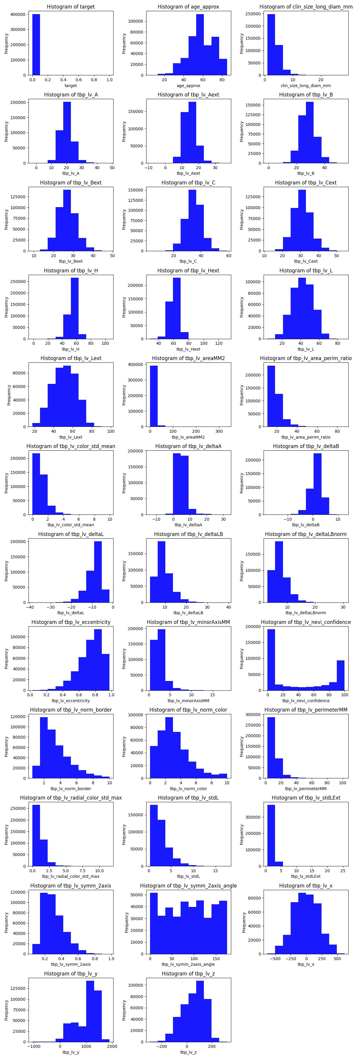
Tabular Data Analysis
Checked the distribution of numerical features using histogram plots

Slide 8
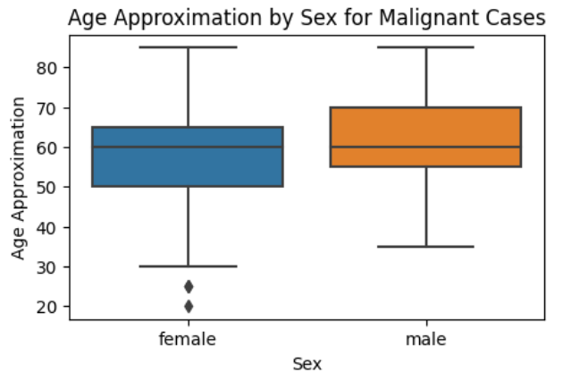
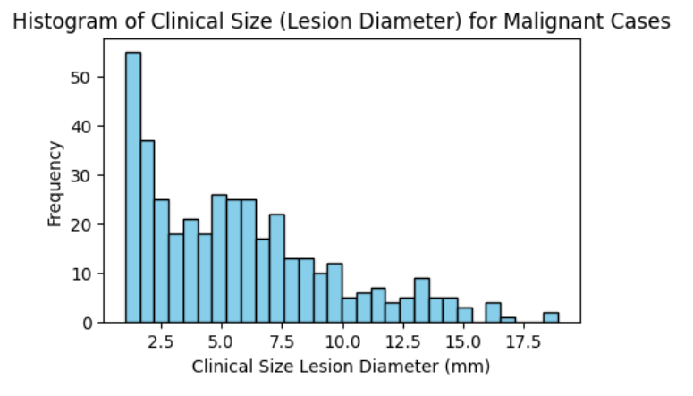
Tabular Data Analysis

Slide 9
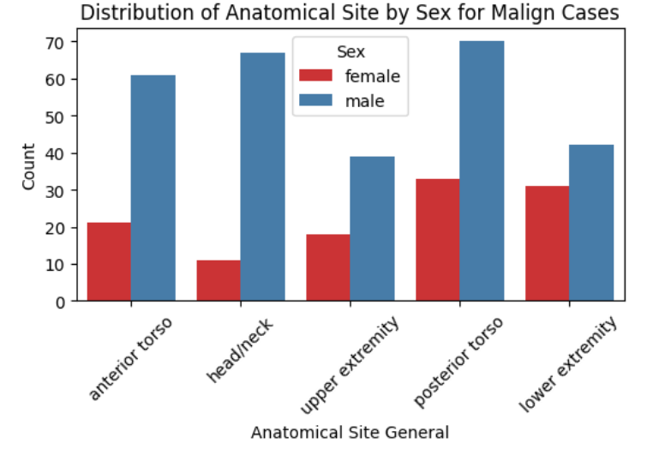
Tabular Data Analysis

Slide 10
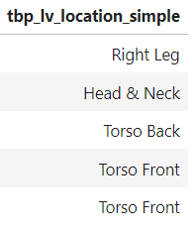
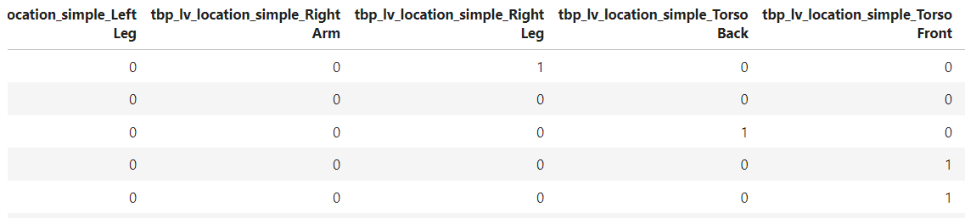
Tabular Data Encoding
Encoded categorical columns using one-hot encoding

Slide 11
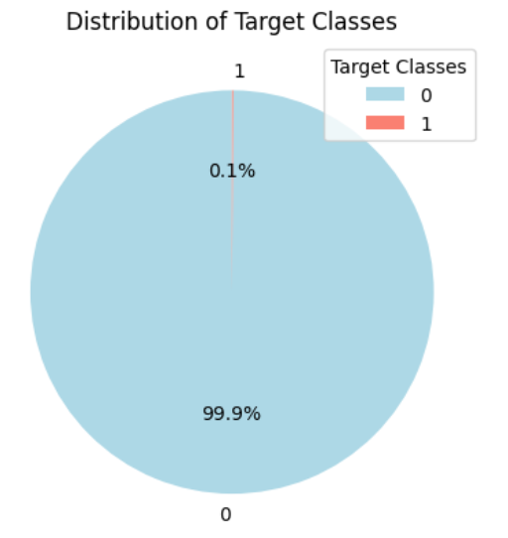
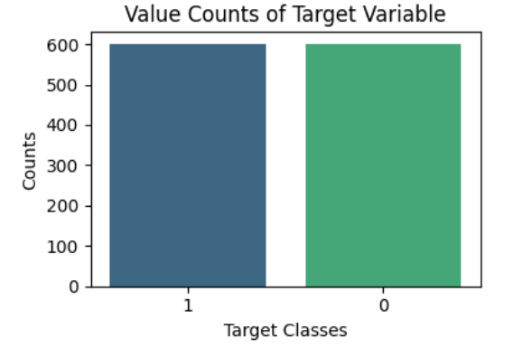
Handling Class Imbalance
Undersampled the majority class to 600 samples
Oversampled the minority class to 600 samples using SMOTE
Before
After

Slide 12
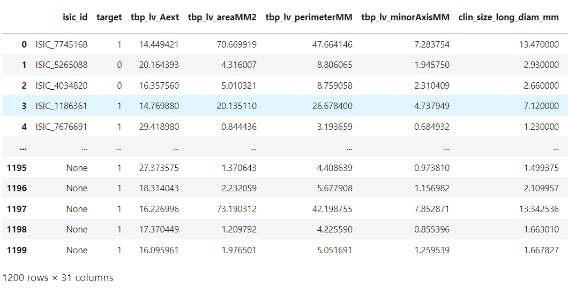
Feature Selection
Calculated the correlation matrix
Get correlation with the target variable
Keep only features with high correlation to the target: absolute corr > 0.1

Slide 13
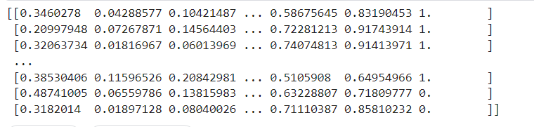
Data Splitting and Scaling
Split the data into train and test (20% test)
Rescaled the data using MinMaxScaler because it’s not normally distributed
The training data after scaling

Slide 14
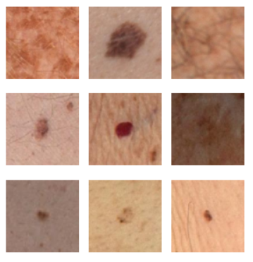
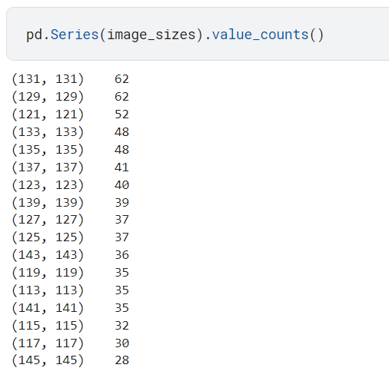
Image Preprocessing
Loaded images with the same isic_ids in the tabular data
Resized all images to 150*150*3
Normalized all images
Saved all images in a numpy array with shape (count_images, 150,150,3) and their labels and IDs in another array
A sample of the loaded images
Sizes of original images before resizing

Slide 15
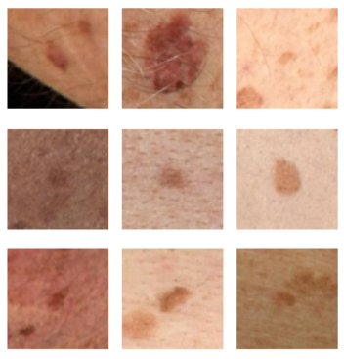
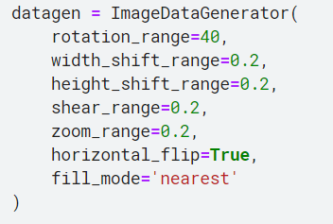
Handling Image data imbalance
Used Image Augmentation to oversample the minority class images
Reordered the metadata to align with the order of the image IDs
Split the image data into train and test with the same indices used to split the metadata
Sample of the augmented images

Slide 16
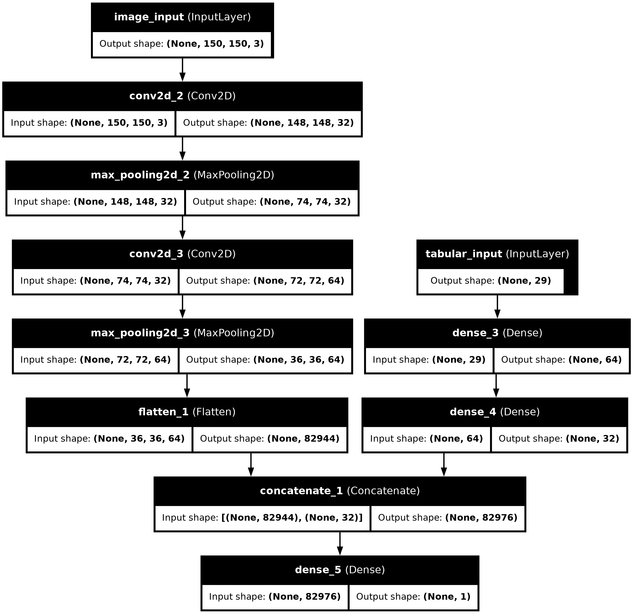
Model Architecture

Slide 17
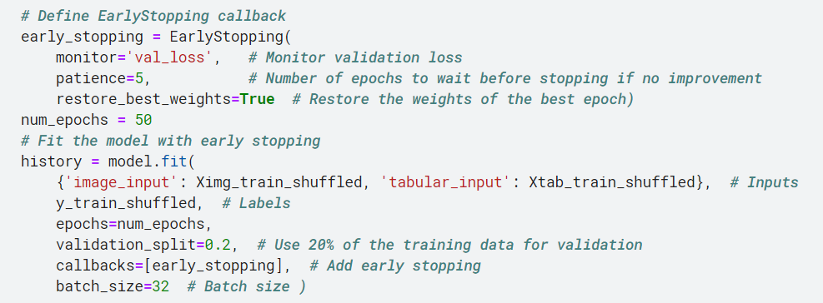
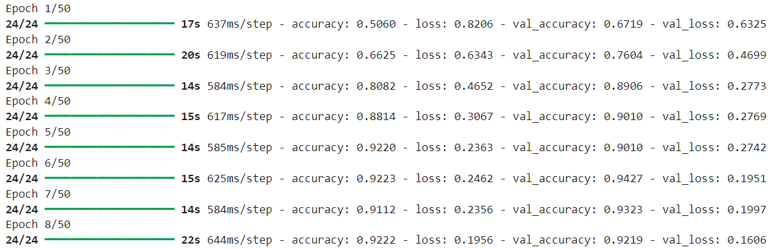
Model Training

Slide 18
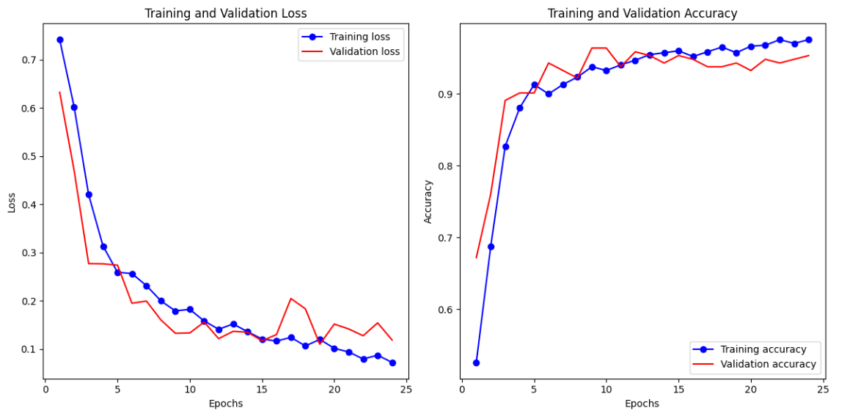
Model Training

Slide 19
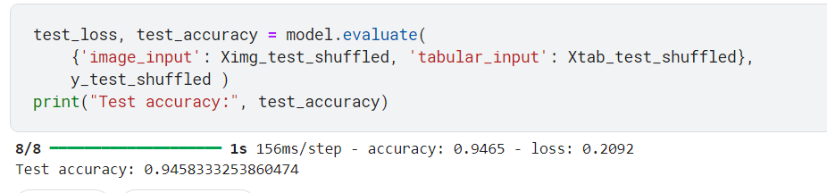
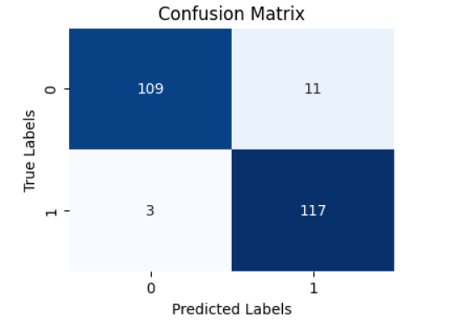
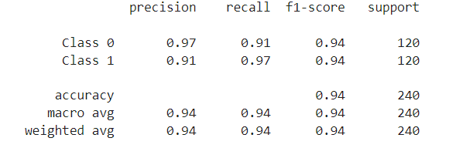
Model Testing and Results

